Slide 1


Port Authority Traffic & Violation Prediction Project
Group 2: Abisha Pandey, Luzaw Shrestha ,Geetika Gorremkala, Iswarya Cherukuri, Saidun Nazam Shakil

Slide 2


Project Overview & Methodology
Business Questions
Selected Models
Predict total traffic volume across facilities
XGBoost Regression
Random Forest Classification
Detect potential toll violations
SARIMA Time Series
Forecast future traffic demand
Implementation
Python (Pandas, Scikit-learn)
Azure AutoML validation
Jupyter Notebook environment

Slide 3



Model 1: Traffic Volume Prediction
Feature Selection
Time: DAY, Month, TIME, Day_Name
Toll & vehicle types: CASH, EZPASS, Autos, Small_T, Large_T, Buses
Weather: Prcp, Snow, Tmax, Tmin, Awnd
Location: FAC_B (facility)
XGBoost Implementation
Gradient Boosting Machine
Handles numerical & categorical data
Industry standard for transportation
Performance Results
Mean Squared Error: 32.27
R² Score: 0.9996
Exceptional accuracy

Slide 4






Model 2: Toll Violation Detection
98% Accuracy
Exceptional classification performance
Random Forest Classifier
Ideal for mixed data types
Comprehensive Features
Time, toll usage, vehicle types, weather, location

Slide 5
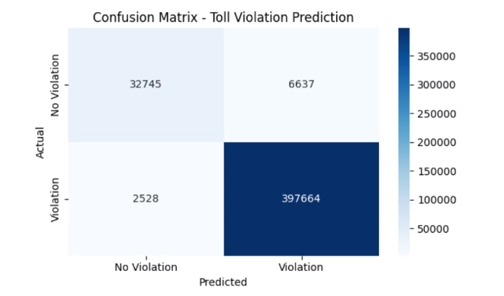
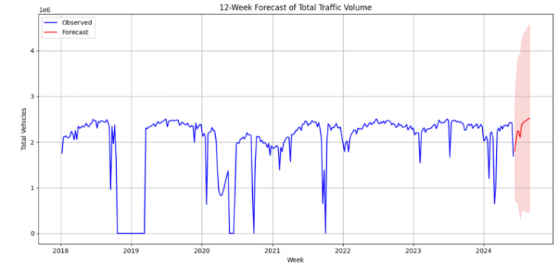
Figurative Outputs
Actual and Predicted Toll Violation Prediction
12 Week forecast of total Traffic Volume

Slide 6
Model 3: Traffic Forecasting
1
SARIMA Model
Seasonal ARIMA configuration (1,1,1)(1,1,1,52)
Captures yearly seasonal patterns
2
Weekly Aggregation
Data grouped by week using Date field
Optimized for operational planning
3
12-Week Forecast
Accurate predictions with seasonal alignment
Confidence intervals for fluctuation insights

Slide 7
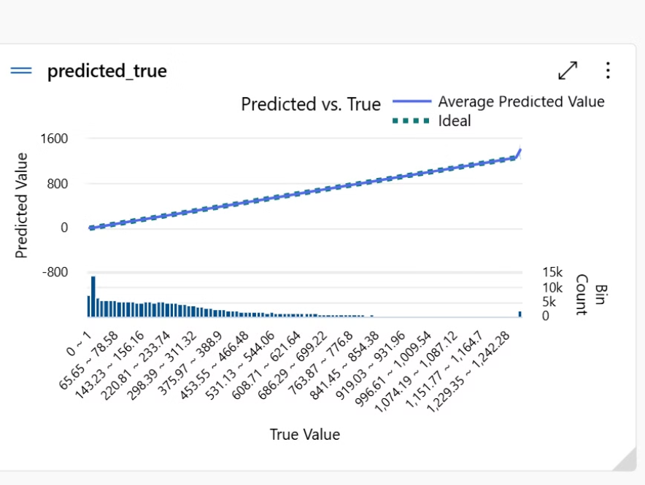
Azure AutoML Integration
The predicted values (blue line) closely align with the ideal values (green dotted line), indicating high model accuracy with minimal prediction error—supported by an R² of 0.9996 and low RMSE.
Most data points fall within moderate traffic ranges, yet the model maintains strong performance across all traffic volumes, including high-density periods.

Slide 8

Recommendations & Conclusion
Targeted Enforcement
Strategic Maintenance
Deploy law enforcement or surveillance more strategically at times/locations where violations are most likely to occur
Real-Time Alerts
Schedule repairs during predicted low-traffic periods to minimize disruptions
Dynamic Toll Pricing
Integrate predictions on display boards to inform drivers about expected congestion and suggest alternative routes
Adjust prices based on predicted high-traffic periods to manage congestion and optimize road usage

